Slide 1


Apache Beam &
Google Cloud Dataflow
+
Slides by Frances Perry, April 2016
Notes:
These slides provide a brief introduction to Google Cloud Dataflow and how it supports Beam. You will likely want to use this in conjunction with other general materials about Beam, and Beam on other runners. You are welcome to reuse all or some of these slides when discussing Apache Beam, but please give credit to the original authors when appropriate. ;-)
Frances Perry (fjp@google.com)
Please comment if you have suggestions or see things that are out of date -- we’d like to keep these fresh and usable for everyone.
Depending on your audience, you may want to adjust or augment this material with other Beam talks.

Slide 2
Beam Model: Asking the Right Questions
What results are calculated?
Where in event time are results calculated?
When in processing time are results materialized?
How do refinements of results relate?
Notes:
The Beam model is based on four key questions:
What results are calculated? Are you doing computing sums, joins, histograms, machine learning models?
Where in event time are results calculated? How does the time each event originally occurred affect results? Are results aggregated for all time, in fixed windows, or as user activity sessions?
When in processing time are results materialized? Does the time each element arrives in the system affect results? How do we know when to emit a result? What do we do about data that comes in late from those pesky users playing on transatlantic flights?
And finally, how do refinements relate? If we choose to emit results multiple times, is each result independent and distinct, do they build upon one another?
Let’s take a quick look at how we can use this questions to build a pipeline.

Slide 3
What is Apache Beam?
The Beam Model: What / Where / When / How
SDKs for writing Beam pipelines -- starting with Java
Runners for Existing Distributed Processing Backends
Apache Flink (thanks to dataArtisans)
Apache Spark (thanks to Cloudera)
Google Cloud Dataflow (fully managed service)
Local (in-process) runner for testing
Notes:
Today, Apache Beam includes
the unified programming model for writing data processing pipelines revolving around the what/where/when/how questions [NOTE: See other slide decks for an introduction to this model]
the initial Java SDK that we developed as part of Cloud Dataflow, with others, including Python, to follow
and, most important for portability, multiple runners that can execute Beam pipelines on existing distributed process backends.

Slide 4
The Cloud Dataflow Service
A great place for executing Beam pipelines which provides:
Fully managed, no-ops execution environment
Integration with Google Cloud Platform
Java support in GA. Python in Alpha.
Notes:
One of those runners is Google Cloud Dataflow. It’s a fully managed service for executing these pipelines on Google Cloud Platform.

Slide 5


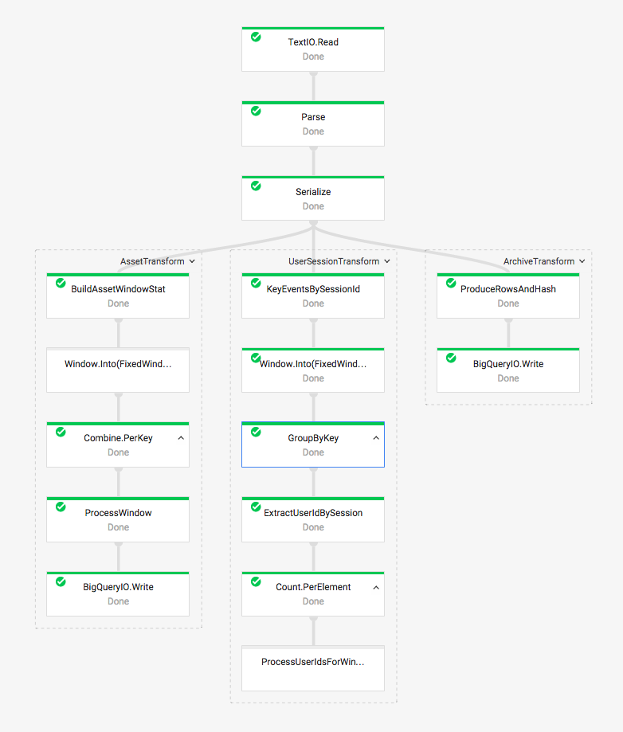

Fully Managed: Worker Lifecycle Management
Deploy
Tear Down
Notes:
Workers are created at job submission and torn down when the job completes (or not for streaming jobs!).

Slide 6
Fully Managed: Dynamic Worker Scaling
Notes:
Cloud Dataflow configures the number of workers throughout the job lifetime to deal with changes in data size within a batch pipeline and changes in throughput in a streaming pipeline.

Slide 7
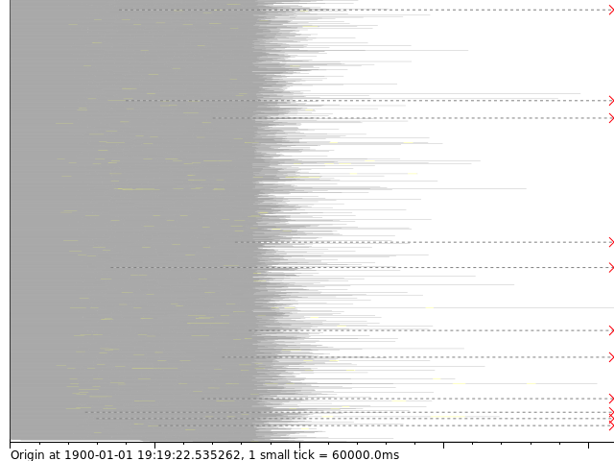
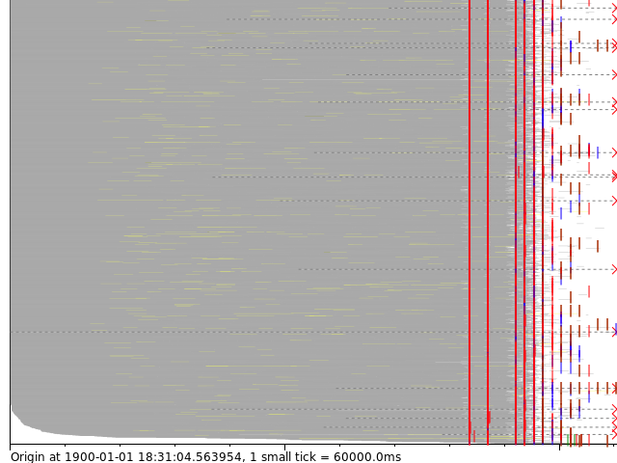
Fully Managed: Dynamic Work Rebalancing
100 mins.
65 mins.
vs.
Notes:
Cloud Dataflow identifies “straggler shards” and automatically rebalances their workloads across available workers which can drastically reduce the overall execution time of batch jobs.

Slide 8










Integrated: Part of Google Cloud Platform
Capture
Process
Store
Analyze
Google App Engine
Cloud Dataproc
BigQuery Storage (tables)
BigQuery Analytics (SQL)
Cloud Logs
Batch
Stream
Google Analytics Premium
Cloud Dataflow
Cloud Bigtable (NoSQL)
Cloud Dataflow
Real time analytics and Alerts
Cloud Pub/Sub
Cloud Storage
(files)
Cloud Dataproc
Cloud Monitoring
Cloud DataStore
Cloud Bigtable
‹#›
Notes:
Complete integration with Google Cloud Platform.

Slide 9
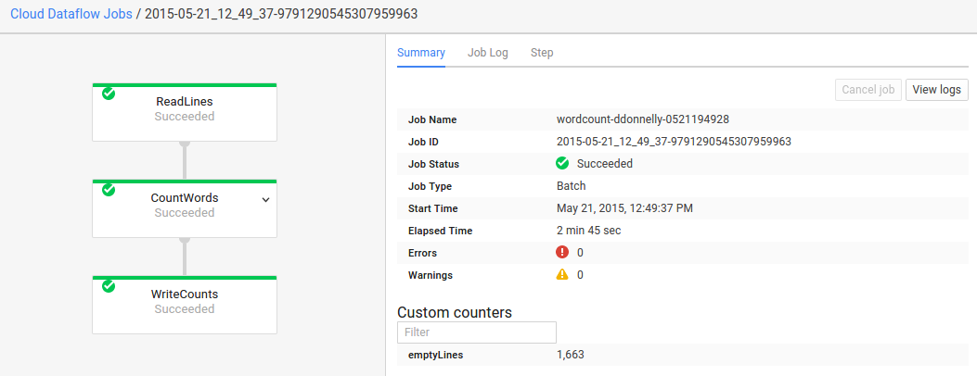
Integrated: Monitoring UI
Notes:
Complete monitoring UI for understanding job progress and execution.

Slide 10
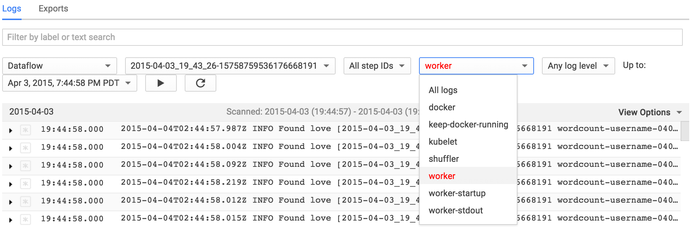
Integrated: Distributed Logging
Notes:
Fully integrated with Cloud Logging for easy access to logs from across workers.

Slide 11
Transitioning from Dataflow 1.x to Beam
Feb 2016
~Fall 2016
Dataflow Java 1.x
Apache Beam Java 0.x
Bug Fix
Feature
Breaking Change
Apache Beam Java 2.x
Notes:
We are in the process of bootstrapping the Apache Beam project. We have forked off from the existing Dataflow Java SDK and are doing some refactoring in order to make the code truly extensible by other runners. Once that is stabilized, Beam will begin a regular cadence of releases.
<animate> For GCP users who want to use this model on Cloud Dataflow, we encourage you to stick with the current Dataflow 1.x SDKs for now. Once Beam has stabilized it, we will begin officially supporting it on the Cloud Dataflow service. At this point, we will begin deprecation of the existing Dataflow SDKs, but of course still support them for a long overlap period so that users have a smooth upgrade experience.
We expect the end-user API differences between Dataflow 1.x and Beam to be relatively minimal. For example, package paths will change from com.google.cloud.dataflow to org.apache.beam. In other words, you can think of Beam as just Dataflow 2.0.

Slide 12
Learn More!
Cloud Dataflow http://cloud.google.com/dataflow/
Cloud Dataflow on Stack Overflow http://www.stackoverflow.com/questions/tagged/google-cloud-dataflow
Apache Beam https://beam.apache.org
+

Slide 13
Thank you!
Notes:
[Thank you for using this slide deck and sharing your enthusiasm about Beam! If you receive any interesting questions, please consider adding the to the community driven Talk FAQ. And feel free to add comments to the deck or contact the authors directly.]

